Slide 1
Qt编程 实验目录
1.实验内容
2.实验目的
3.实验平台
4.程序完成指标
5.实验参考
6.实验步骤
7.参考程序
8.思考题

Slide 2
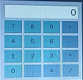
Qt编程 一、实验内容
编写Qt程序，完成计算器功能，计算器界面如图,
要求：
(1)计算器能够实现+、-、*、/运算。
(2)运算操作顺序：
输入第一个数
单击运算符
输入第二个数
输入=进行运算，并显示结果
(3)程序在FS6818M4实验箱上运行

Slide 3
Qt编程 二、实验目的
1.学习了解信号、槽技术以及编程方法。
2.计算器小程序的编程方法和调试技巧。

Slide 4
Qt编程 三、实验平台
1.硬件
计算机 1台
FS_6818M4_V2实验箱 1台
2.软件
(1)台式计算机
操作系统： Windows10
虚拟机: VMware-player-15.1.0
Ubuntu18.04
ubuntu-18.04-64bit_farsight(包含Qt,ARM-Qt)
超级终端：PUTTY.EXE
(2) FS_6818M4_V2实验箱
嵌入式Linux操作系统

Slide 5
Qt编程 四、实验完成指标
运行计算器程序，
显示计算器操作主窗口
输入第一个数
单击运算符
输入第二个数
输入=运算并显示结果

Slide 6
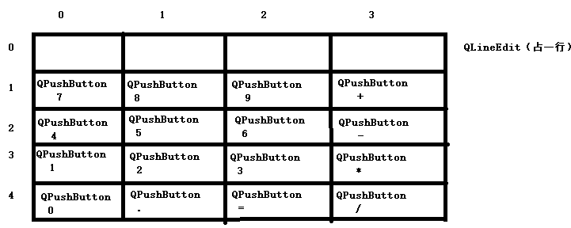
Qt编程 五、实验参考
1. 计算器界面控件：
控件1：QLineEdit,用于录入第1、2个数据和显示运算结果;
控件2：QPushButton,9个数字按钮，用于录入0…9数字;
控件3：QPushButton,4个运算符按钮，用于输入+、-、*、\运算符；
控件4：QPushButton,1个运算符按钮，用于输入=，执行算数运算。
2.网格布局控件
QGridLayout *mainLayout = new QGridLayout;

Slide 7
Qt编程 五、实验参考
3.在界面中布置控件：
mainLayout->addWidget(display, 0, 0, 1,4); //摆放QLineEdit，占4格
mainLayout->addWidget(d0Button, 4, 0); //在(4,0)位置摆放QPushButton0
mainLayout->addWidget(d1Button, 3, 0);
mainLayout->addWidget(d2Button, 3, 1);
mainLayout->addWidget(d3Button, 3, 2);
mainLayout->addWidget(d4Button, 2, 0);
mainLayout->addWidget(d5Button, 2, 1);
mainLayout->addWidget(d6Button, 2, 2);
mainLayout->addWidget(d7Button, 1, 0);
mainLayout->addWidget(d8Button, 1, 1);
mainLayout->addWidget(d9Button, 1, 2);
mainLayout->addWidget(pointButton, 4, 1);
mainLayout->addWidget(equalButton, 4, 2);
mainLayout->addWidget(divButton, 4, 3);
mainLayout->addWidget(timesButton, 3, 3);
mainLayout->addWidget(subButton, 2, 3);
mainLayout->addWidget(addButton, 1, 3);
setLayout(mainLayout);//设置界面为网格布局

Slide 8
Qt编程 五、实验参考
4.信号、槽
（1）
信号：对控件进行操作时，生成信号，相当于C++中的消息，只是信号用函数表示，比如单击按钮时，生成单击信号
clicked().
槽:相当与C++的相应函数。
（2）信号与槽建立关联：一旦信号与槽建立关联，当操作控件时，生成信号，调用与其关联的槽函数.
例如:
connect(d0Button,SIGNAL(clicked()),this,SLOT(d0Clicked()));
connect:将信号与槽建立关联。
第一个参数：控件
第二个参数：信号
第三个参数：控件对象
第四个参数：槽
本例，当单击D0Button按钮时，生成单击信号clicked(),调用槽函数d0Clienked()。

Slide 9
Qt编程 五、实验参考
（3）
connect(d0Button,SIGNAL(clicked()),this,SLOT(d0Clicked())); connect(d1Button,SIGNAL(clicked()),this,SLOT(d1Clicked())); connect(d2Button,SIGNAL(clicked()),this,SLOT(d2Clicked())); connect(d3Button,SIGNAL(clicked()),this,SLOT(d3Clicked())); connect(d4Button,SIGNAL(clicked()),this,SLOT(d4Clicked())); connect(d5Button,SIGNAL(clicked()),this,SLOT(d5Clicked())); connect(d6Button,SIGNAL(clicked()),this,SLOT(d6Clicked())); connect(d7Button,SIGNAL(clicked()),this,SLOT(d7Clicked())); connect(d8Button,SIGNAL(clicked()),this,SLOT(d8Clicked())); connect(d9Button,SIGNAL(clicked()),this,SLOT(d9Clicked())); connect(pointButton,SIGNAL(clicked()),this,SLOT(pointClicked())); connect(equalButton,SIGNAL(clicked()),this,SLOT(equalClicked())); connect(addButton,SIGNAL(clicked()),this,SLOT(addClicked())); connect(subButton,SIGNAL(clicked()),this,SLOT(subClicked())); connect(timesButton,SIGNAL(clicked()),this,SLOT(mulClicked())); connect(divButton,SIGNAL(clicked()),this,SLOT(divClicked()));

Slide 10
Qt编程 五、实验参考
5.数据录入与运算
(1)数字变量
CString strFirst;第一个数
Cstring strSecond;第二个数
(2)录入,在数字按钮的槽函数中进行
Inputindex=0 录入第1个数
strFirst=strFirst+tr(“0”); //”0”单击按钮0时
Inputindex=1 录入第2个数
strSecond=strSecond(“0”); //”0”单击按钮0时
(3)第一个数与第二个数录入切换，在运算符按钮的槽函数中进行
单击运算符按钮时，切换
if (inputindex==0) inputindex=1;
(4)在=按钮槽函数中进行
nFirst = strFirst.toInt();
nSecond=strSecond.toInt();
nResult=nFirst+nSecond;
display->setText(QString::number(nResult));

Slide 11
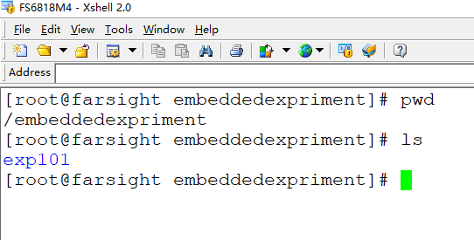
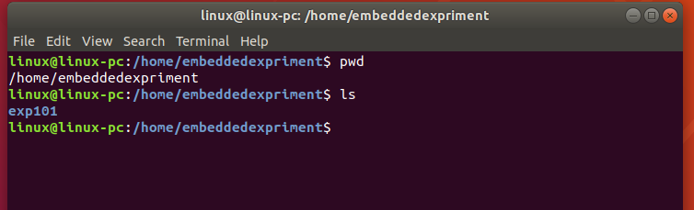
Qt编程 六、实验步骤
1.确认编程环境准备好
(1).确认VM ubuntu18.04已经启动
(2).确认实验箱已经启动
如果没有准备好，参考实验1.1，
安装实验1.1步骤启动ubuntu18.04和实验箱

Slide 12
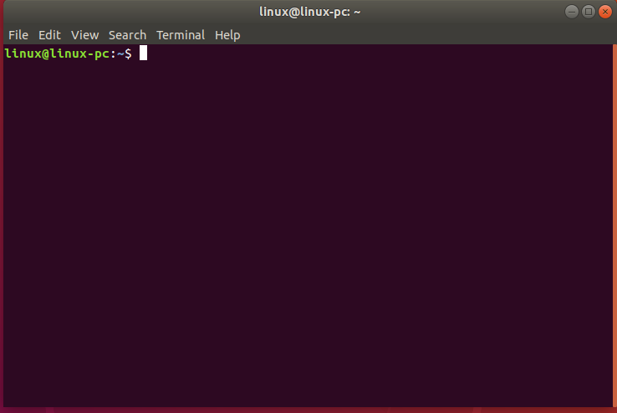
Qt编程 六、实验步骤
2.ubuntu18.04下，进入“终端”
在ubuntu18.04操作主窗口，按组合键CTRL+ALT+T,进入终端窗口

Slide 13
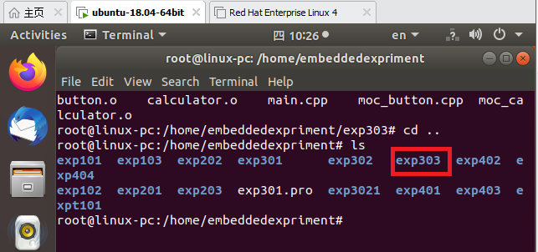
Qt编程 六、实验步骤
3.编程
(1)进入 /home/embeddedexpriment目录
(2)创建实验3的第3个小实验实验目录exp303
$pwd
$su root
Password: 1
# mkdir exp303
# cd exp303
# pwd
/home/embeddedexpriment/exp302

Slide 14
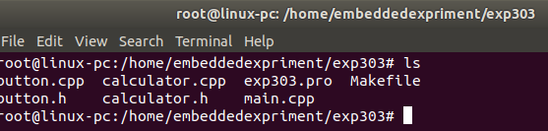
Qt编程 六、实验步骤
(3)在exp303下编写程序
root@linux-pc:/home/embeddedexpriment/exp302# vim button.h
root@linux-pc:/home/embeddedexpriment/exp302# vim button.cpp
root@linux-pc:/home/embeddedexpriment/exp302# vim calculator.h
root@linux-pc:/home/embeddedexpriment/exp302# vim calculator.cpp
root@linux-pc:/home/embeddedexpriment/exp302# vim main.cpp

Slide 15
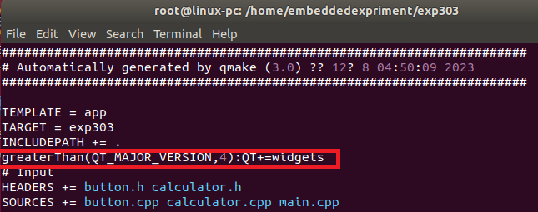
Qt编程 六、实验步骤
(4)使用Qmake生成Makefile
/exp303# ls
button.cpp calculator.cpp
button.h calculator.h main.cpp
root@linux-pc:/home/embeddedexpriment/exp303#/opt/qt/bin/qmake –project
root@linux-pc:/home/embeddedexpriment/exp303#/opt/qt/bin/qmake
root@linux-pc:/home/embeddedexpriment/exp303# ls
button.cpp calculator.cpp exp303.pro Makefile
button.h calculator.h main.cpp
root@linux-pc:/home/embeddedexpriment/exp303# vim exp303.pro
root@linux-pc:/home/embeddedexpriment/exp303#

Slide 16
Qt编程 六、实验步骤
4.编译、链接
root@linux-pc:/home/embeddedexpriment/exp303# ls
button.cpp calculator.cpp exp303.pro Makefile
button.h calculator.h main.cpp
root@linux-pc:/home/embeddedexpriment/exp303# make
root@linux-pc:/home/embeddedexpriment/exp303# ls
button.cpp calculator.cpp exp303 main.o moc_button.o
button.h calculator.h exp303.pro Makefile moc_calculator.cpp
button.o calculator.o main.cpp moc_button.cpp moc_calculator.o
root@linux-pc:/home/embeddedexpriment/exp303#

Slide 17
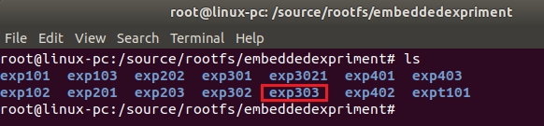
Qt编程 六、实验步骤
5.exp303拷贝到/sources/rootfs/embeddedexpriment
root@linux-pc:/home/embeddedexpriment/exp303# cd ..
root@linux-pc:/home/embeddedexpriment# cp –rf exp303/ /source/rootfs/embeddedexpriment
root@linux-pc:/home/embeddedexpriment# cd /source/rootfs/embeddedexpriment
root@linux-pc:/source/rootfs/embeddedexpriment#

Slide 18
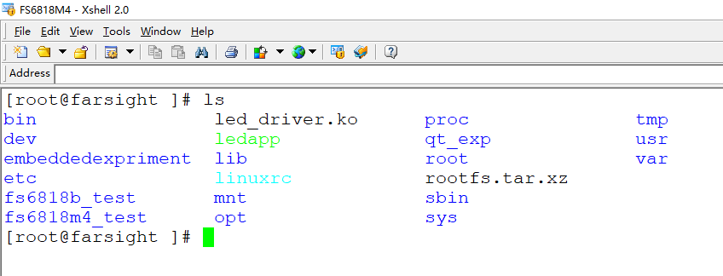
Qt编程 六、实验步骤
6.运行程序
(1)激活fs6818M4会话窗口,进入exp302目录

Slide 19
Qt编程 六、实验步骤
(2)执行程序
[root@farsight ]# ls
bin led_driver.ko proc tmp
dev ledapp qt_exp usr
embeddedexpriment lib root var
etc linuxrc rootfs.tar.xz
fs6818b_test mnt sbin
fs6818m4_test opt sys
[root@farsight ]# cd embeddedexpriment/
[root@farsight embeddedexpriment]# ls
exp101 exp103 exp202 exp301 exp3021 exp401 exp403
exp102 exp201 exp203 exp302 exp303 exp402 expt101
[root@farsight embeddedexpriment]# cd exp303
[root@farsight exp303]# ls
Makefile calculator.cpp exp303.pro moc_button.o
button.cpp calculator.h main.cpp moc_calculator.cpp
button.h calculator.o main.o moc_calculator.o
button.o exp303 moc_button.cpp
[root@farsight exp303]# ./exp303
[ 40.460000] <<-GTP-INFO->> System resume.
[ 40.467000] <<-GTP-INFO->> GTP wakeup sleep.
录入 2+3=?
12+23=?

Slide 20
Qt编程 七、实验参考程序
1.main.cpp主程序
#include <QtWidgets/QApplication>
#include "calculator.h"
int main(int argc, char *argv[])
{
QApplication app(argc, argv);
Calculator calc;
calc.show();
return app.exec();
}

Slide 21
Qt编程 七、实验参考程序
2.button.h
#ifndef BUTTON_H
#define BUTTON_H
#include <QtWidgets/QToolButton>
class Button : public QToolButton
{
Q_OBJECT
public:
Button(const QString &text, const QColor &color, QWidget *parent = 0);
QSize sizeHint() const;
};
#endif

Slide 22
Qt编程 七、实验参考程序
3.button.cpp
#include <QtWidgets>
#include "button.h"
Button::Button(const QString &text, const QColor &color, QWidget *parent)
: QToolButton(parent)
{
setSizePolicy(QSizePolicy::Expanding, QSizePolicy::Preferred);
setText(text);
QPalette newPalette = palette();
newPalette.setColor(QPalette::Button, color);
setPalette(newPalette);
}
QSize Button::sizeHint() const
{
QSize size = QToolButton::sizeHint();
size.rheight() += 20;
size.rwidth() = qMax(size.width(), size.height());
return size;
}

Slide 23
Qt编程 七、实验参考程序
4. calculator.h
#ifndef CALCULATOR_H
#define CALCULATOR_H
#include <QtWidgets/QDialog>
QT_BEGIN_NAMESPACE
class QLineEdit;
QT_END_NAMESPACE
class Button;
class Calculator : public QDialog
{
Q_OBJECT
public:
Calculator(QWidget *parent = 0);

Slide 24
Qt编程 七、实验参考程序
private slots:
void d0Clicked();
void d1Clicked();
void d2Clicked();
void d3Clicked();
void d4Clicked();
void d5Clicked();
void d6Clicked();
void d7Clicked();
void d8Clicked();
void d9Clicked();
void addClicked(); // 加+
void mulClicked(); // 乘*
void subClicked(); // 减-
void divClicked(); // 除/
void equalClicked(); // 运算=
void pointClicked(); // 小数点 .

Slide 25
Qt编程 七、实验参考程序
private:
Button *createButton(const QString &text, const QColor &color);
double nFirst,nSecond;
double nResult;
int index; //index=0 + 1 - 2 * 3 /
int inputindex; //0:no 1:strFirst 2:strSecond
QString strFirst,strSecond;
QLineEdit *display;
Button *d0Button,*d1Button,*d2Button,*d3Button;
Button *d4Button,*d5Button,*d6Button,*d7Button;
Button *d8Button,*d9Button;
Button *addButton;
Button *subButton;
Button *timesButton;
Button *divButton;
Button *pointButton;
Button *equalButton;
};
#endif

Slide 26
Qt编程 七、实验参考程序
5. calculator.cpp
#include <QtWidgets>
#include <math.h>
#include "button.h"
#include "calculator.h"
Calculator::Calculator(QWidget *parent)
: QDialog(parent)
{
nFirst=0.0;
nSecond=0.0;
nResult=0.0;
index=0;
inputindex=0; //0:strFirst 1:strSecond
strFirst="";
strSecond="";

Slide 27
Qt编程 七、实验参考程序
display = new QLineEdit("0");
display->setReadOnly(false);
display->setAlignment(Qt::AlignRight);
display->setMaxLength(15);
// display->setValidator(new QIntValidator(1,65536));
QFont font = display->font();
font.setPointSize(font.pointSize() + 8);
display->setFont(font);
QColor digitColor(150, 205, 205);
QColor backspaceColor(225, 185, 135);
QColor memoryColor(100, 155, 155);
QColor operatorColor(155, 175, 195);

Slide 28
Qt编程 七、实验参考程序
d0Button= createButton(tr("0"), digitColor);
d1Button= createButton(tr("1"), digitColor);
d2Button= createButton(tr("2"), digitColor);
d3Button= createButton(tr("3"), digitColor);
d4Button= createButton(tr("4"), digitColor);
d5Button= createButton(tr("5"), digitColor);
d6Button= createButton(tr("6"), digitColor);
d7Button= createButton(tr("7"), digitColor);
d8Button= createButton(tr("8"), digitColor);
d9Button= createButton(tr("9"), digitColor);
addButton= createButton(tr("+"),operatorColor);
subButton= createButton(tr("-"),operatorColor);
timesButton= createButton(tr("*"),operatorColor);
divButton= createButton(tr("/"),operatorColor);
equalButton= createButton(tr("="),operatorColor);
pointButton= createButton(tr("."),operatorColor);

Slide 29
Qt编程 七、实验参考程序
connect(d0Button,SIGNAL(clicked()),this,SLOT(d0Clicked()));
connect(d1Button,SIGNAL(clicked()),this,SLOT(d1Clicked()));
connect(d2Button,SIGNAL(clicked()),this,SLOT(d2Clicked()));
connect(d3Button,SIGNAL(clicked()),this,SLOT(d3Clicked()));
connect(d4Button,SIGNAL(clicked()),this,SLOT(d4Clicked()));
connect(d5Button,SIGNAL(clicked()),this,SLOT(d5Clicked()));
connect(d6Button,SIGNAL(clicked()),this,SLOT(d6Clicked()));
connect(d7Button,SIGNAL(clicked()),this,SLOT(d7Clicked()));
connect(d8Button,SIGNAL(clicked()),this,SLOT(d8Clicked()));
connect(d9Button,SIGNAL(clicked()),this,SLOT(d9Clicked()));
connect(pointButton,SIGNAL(clicked()),this,SLOT(pointClicked()));
connect(equalButton,SIGNAL(clicked()),this,SLOT(equalClicked()));
connect(addButton,SIGNAL(clicked()),this,SLOT(addClicked()));
connect(subButton,SIGNAL(clicked()),this,SLOT(subClicked()));
connect(timesButton,SIGNAL(clicked()),this,SLOT(mulClicked()));
connect(divButton,SIGNAL(clicked()),this,SLOT(divClicked()));

Slide 30
Qt编程 七、实验参考程序
QGridLayout *mainLayout = new QGridLayout;
mainLayout->setSizeConstraint(QLayout::SetFixedSize);
mainLayout->addWidget(display, 0, 0, 1,4);
mainLayout->addWidget(d0Button, 4, 0);
mainLayout->addWidget(d1Button, 3, 0);
mainLayout->addWidget(d2Button, 3, 1);
mainLayout->addWidget(d3Button, 3, 2);
mainLayout->addWidget(d4Button, 2, 0);
mainLayout->addWidget(d5Button, 2, 1);
mainLayout->addWidget(d6Button, 2, 2);
mainLayout->addWidget(d7Button, 1, 0);
mainLayout->addWidget(d8Button, 1, 1);
mainLayout->addWidget(d9Button, 1, 2);
mainLayout->addWidget(pointButton, 4, 1);
mainLayout->addWidget(equalButton, 4, 2);
mainLayout->addWidget(divButton, 4, 3);
mainLayout->addWidget(timesButton, 3, 3);
mainLayout->addWidget(subButton, 2, 3);
mainLayout->addWidget(addButton, 1, 3);
setLayout(mainLayout);
setWindowTitle(tr("Calculator"));
}

Slide 31
Qt编程 七、实验参考程序
Button *Calculator::createButton(const QString &text, const QColor &color)
{
Button *button = new Button(text, color);
return button;
}

Slide 32
Qt编程 七、实验参考程序
//**************************
void Calculator::d0Clicked()
{
if(inputindex==0) //0:strFirst 1:strSecond
{
strFirst=strFirst+tr("0");
int digitValue = strFirst.toInt();
if (digitValue == 0) {display->setText("0"); strFirst="";}
else display->setText(strFirst);
qDebug()<<strFirst<<endl;
} else {
strSecond=strSecond+"0";
int digitValue = strSecond.toInt();
if (digitValue == 0) {display->setText("0"); strSecond="";}
else display->setText(strSecond);
qDebug()<<strSecond<<endl;
}
qDebug()<<"0"<<endl;
// QMessageBox::information(this,tr("Input Digital"),tr("Input 0"));
}

Slide 33
Qt编程 七、实验参考程序
void Calculator::d1Clicked()
{
if(inputindex==0) //0:strFirst 1:strSecond
{
strFirst=strFirst+tr("1");
int digitValue = strFirst.toInt();
if (digitValue == 0) {display->setText("0"); strFirst="";}
else display->setText(strFirst);
qDebug()<<strFirst<<endl;
} else {
strSecond=strSecond+"1";
int digitValue = strSecond.toInt();
if (digitValue == 0) {display->setText("0"); strSecond="";}
else display->setText(strSecond);
qDebug()<<strSecond<<endl;
}
qDebug()<<"Digital 1"<<endl;
}

Slide 34
Qt编程 七、实验参考程序
void Calculator::d2Clicked()
{
if(inputindex==0) //0:strFirst 1:strSecond
{
strFirst=strFirst+tr("2");
int digitValue = strFirst.toInt();
if (digitValue == 0) {display->setText("0"); strFirst="";}
else display->setText(strFirst);
qDebug()<<strFirst<<endl;
} else {
strSecond=strSecond+"2";
int digitValue = strSecond.toInt();
if (digitValue == 0) {display->setText("0"); strSecond="";}
else display->setText(strSecond);
qDebug()<<strSecond<<endl;
}
qDebug()<<"Digital 2"<<endl;
}

Slide 35
Qt编程 七、实验参考程序
void Calculator::d3Clicked()
{
if(inputindex==0) //0:strFirst 1:strSecond
{
strFirst=strFirst+tr("3");
int digitValue = strFirst.toInt();
if (digitValue == 0) {display->setText("0"); strFirst="";}
else display->setText(strFirst);
qDebug()<<strFirst<<endl;
} else {
strSecond=strSecond+"3";
int digitValue = strSecond.toInt();
if (digitValue == 0) {display->setText("0"); strSecond="";}
else display->setText(strSecond);
qDebug()<<strSecond<<endl;
}
qDebug()<<"Digital 3"<<endl;
}

Slide 36
Qt编程 七、实验参考程序
void Calculator::d4Clicked()
{
if(inputindex==0) //0:strFirst 1:strSecond
{
strFirst=strFirst+tr("4");
int digitValue = strFirst.toInt();
if (digitValue == 0) {display->setText("0"); strFirst="";}
else display->setText(strFirst);
qDebug()<<strFirst<<endl;
} else {
strSecond=strSecond+"4";
int digitValue = strSecond.toInt();
if (digitValue == 0) {display->setText("0"); strSecond="";}
else display->setText(strSecond);
qDebug()<<strSecond<<endl;
}
qDebug()<<"Digital 4"<<endl;
}

Slide 37
Qt编程 七、实验参考程序
void Calculator::d5Clicked()
{
if(inputindex==0) //0:strFirst 1:strSecond
{
strFirst=strFirst+tr(“5");
int digitValue = strFirst.toInt();
if (digitValue == 0) {display->setText("0"); strFirst="";}
else display->setText(strFirst);
qDebug()<<strFirst<<endl;
} else {
strSecond=strSecond+“5";
int digitValue = strSecond.toInt();
if (digitValue == 0) {display->setText("0"); strSecond="";}
else display->setText(strSecond);
qDebug()<<strSecond<<endl;
}
qDebug()<<"Digital 5"<<endl;
}

Slide 38
Qt编程 七、实验参考程序
void Calculator::d6Clicked()
{
if(inputindex==0) //0:strFirst 1:strSecond
{
strFirst=strFirst+tr(“6");
int digitValue = strFirst.toInt();
if (digitValue == 0) {display->setText("0"); strFirst="";}
else display->setText(strFirst);
qDebug()<<strFirst<<endl;
} else {
strSecond=strSecond+“6";
int digitValue = strSecond.toInt();
if (digitValue == 0) {display->setText("0"); strSecond="";}
else display->setText(strSecond);
qDebug()<<strSecond<<endl;
}
qDebug()<<"Digital 6"<<endl;
}

Slide 39
Qt编程 七、实验参考程序
void Calculator::d7Clicked()
{
if(inputindex==0) //0:strFirst 1:strSecond
{
strFirst=strFirst+tr(“7");
int digitValue = strFirst.toInt();
if (digitValue == 0) {display->setText("0"); strFirst="";}
else display->setText(strFirst);
qDebug()<<strFirst<<endl;
} else {
strSecond=strSecond+“7";
int digitValue = strSecond.toInt();
if (digitValue == 0) {display->setText("0"); strSecond="";}
else display->setText(strSecond);
qDebug()<<strSecond<<endl;
}
qDebug()<<"Digital 7"<<endl;
}

Slide 40
Qt编程 七、实验参考程序
void Calculator::d8Clicked()
{
if(inputindex==0) //0:strFirst 1:strSecond
{
strFirst=strFirst+tr(“8");
int digitValue = strFirst.toInt();
if (digitValue == 0) {display->setText("0"); strFirst="";}
else display->setText(strFirst);
qDebug()<<strFirst<<endl;
} else {
strSecond=strSecond+“8";
int digitValue = strSecond.toInt();
if (digitValue == 0) {display->setText("0"); strSecond="";}
else display->setText(strSecond);
qDebug()<<strSecond<<endl;
}
qDebug()<<"Digital 8"<<endl;
}

Slide 41
Qt编程 七、实验参考程序
void Calculator::d9Clicked()
{
if(inputindex==0) //0:strFirst 1:strSecond
{
strFirst=strFirst+tr(“9");
int digitValue = strFirst.toInt();
if (digitValue == 0) {display->setText("0"); strFirst="";}
else display->setText(strFirst);
qDebug()<<strFirst<<endl;
} else {
strSecond=strSecond+“9";
int digitValue = strSecond.toInt();
if (digitValue == 0) {display->setText("0"); strSecond="";}
else display->setText(strSecond);
qDebug()<<strSecond<<endl;
}
qDebug()<<"Digital 9"<<endl;
}

Slide 42
Qt编程 七、实验参考程序
void Calculator::addClicked() // 加+
{
if (inputindex==0) inputindex=1;
index=1;
qDebug()<<"Digital add"<<endl;
}
void Calculator::mulClicked() // 乘*
{ if (inputindex==0) inputindex=1;
index=3;
qDebug()<<"Digital mul"<<endl;
}
void Calculator::subClicked() // 减-
{ if (inputindex==0) inputindex=1;
index=2;
qDebug()<<"Digital sub"<<endl;
}
void Calculator::divClicked() // 除/
{
if (inputindex==0) inputindex=1;
index=4;
qDebug()<<"Digital div"<<endl;
}

Slide 43
Qt编程 七、实验参考程序
void Calculator::equalClicked() // 运算=
{
nFirst = strFirst.toInt();
nSecond=strSecond.toInt();
switch(index)
{
case 1:
{
nResult=nFirst+nSecond;
display->setText(QString::number(nResult));
}
break;
case 2:
{
nResult=nFirst-nSecond;
display->setText(QString::number(nResult));
}
break;
case 3:
{
nResult=nFirst*nSecond;
display->setText(QString::number(nResult));
}
break;

Slide 44
Qt编程 七、实验参考程序
case 4:
{
nResult=nFirst/nSecond;
display->setText(QString::number(nResult));
}
break;
}
index=0;
nFirst=0;
nSecond=0;
strFirst="";
strSecond="";
inputindex=0;
nResult=0;
qDebug()<<"Digital ="<<endl;
}
void Calculator::pointClicked() // 小数点 .
{
qDebug()<<"Digital point"<<endl;
}

Slide 45
Qt编程 七、实验参考程序
6.exp303.pro
TEMPLATE = app
TARGET = exp303
INCLUDEPATH += .
greaterThan(QT_MAJOR_VERSION,4):QT+=widgets
# Input
HEADERS += button.h calculator.h
SOURCES += button.cpp calculator.cpp main.cpp

